Slide 1
LinGo
A diversified shopping guide service system
Project Leader 胡鑫航
Team Member 洪鑫裕，林之巍，范岚琦，孙钰婷

Slide 2
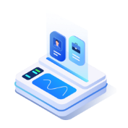



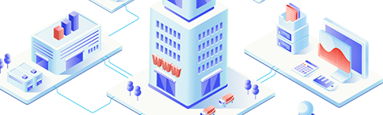

CONTENTS
01
02
03
04
Project Origin
Project Solution
Project Presentation
Future
Planning

Slide 3
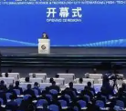

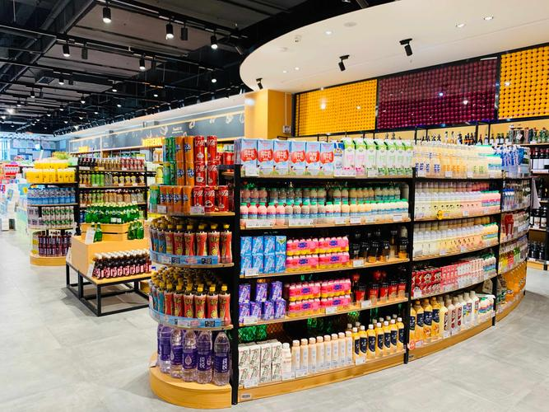

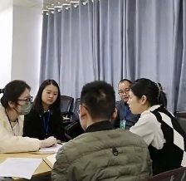
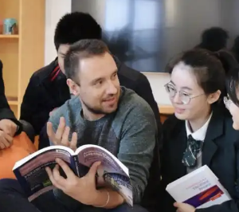
PAIN POINT
Pain spots
Launching Ceremony
Find Out
Searching for goods in markets
Language Barrier on Foreigners
Brainstorm
Consultation/Survey

Slide 4
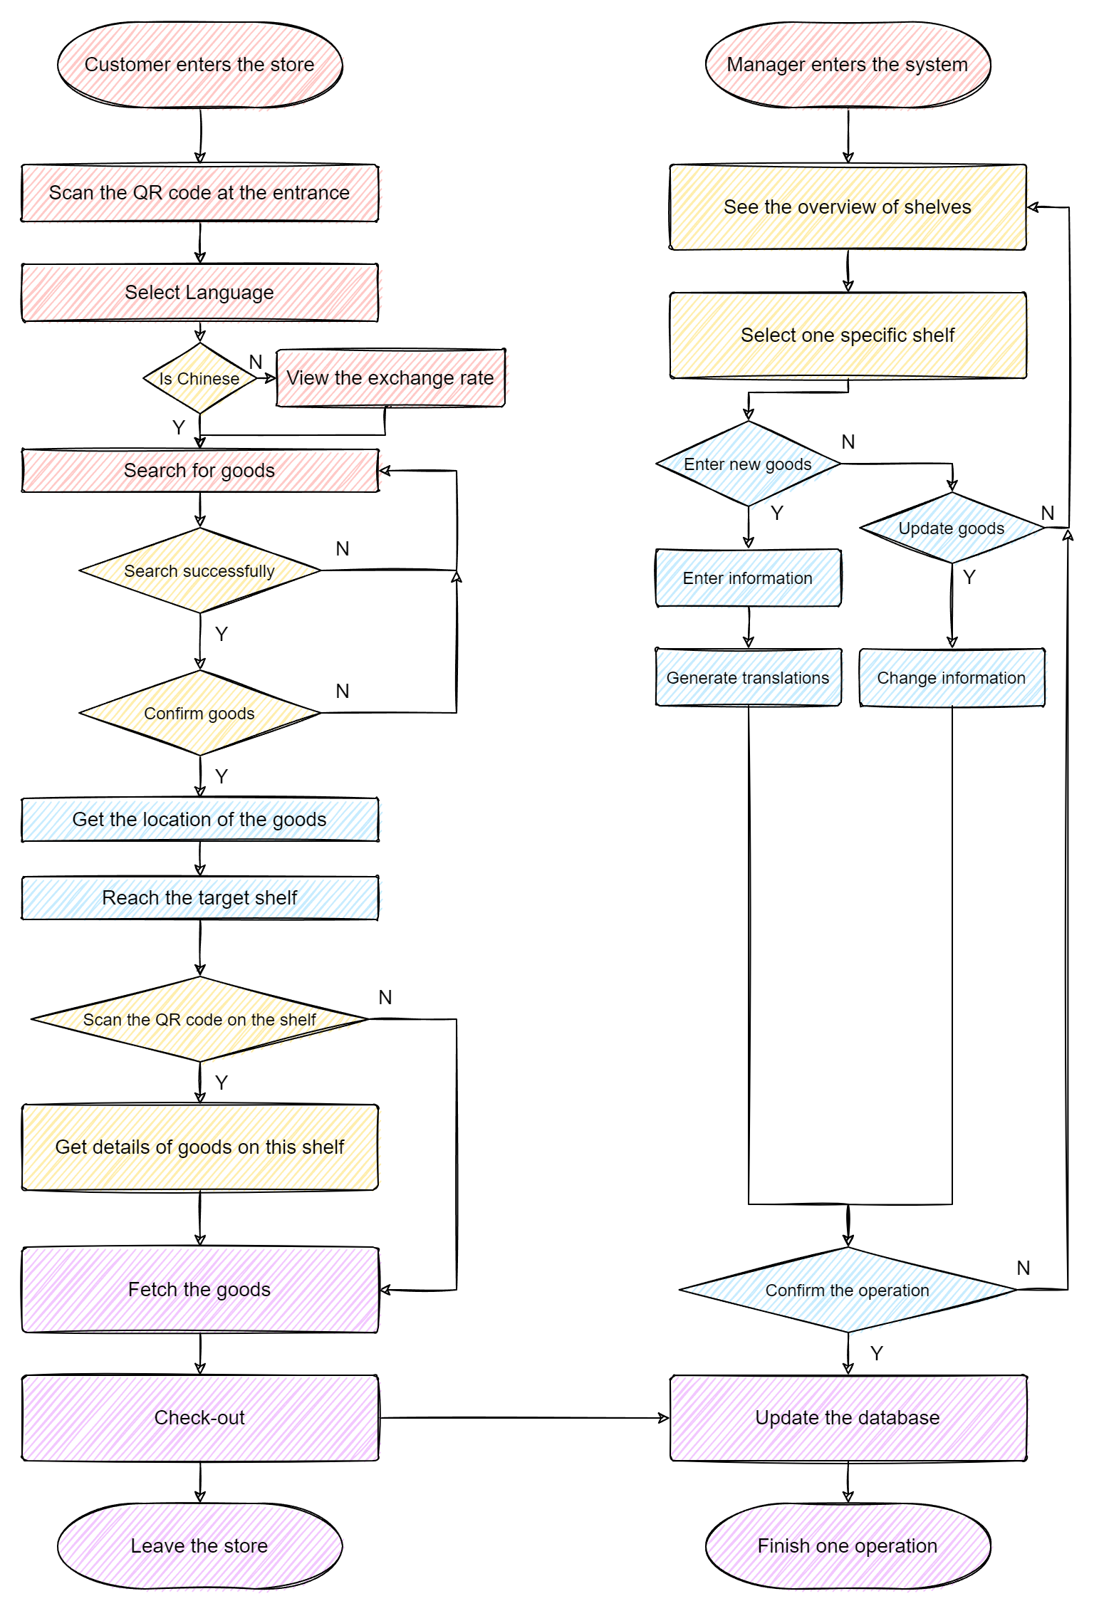
Solution

Slide 5
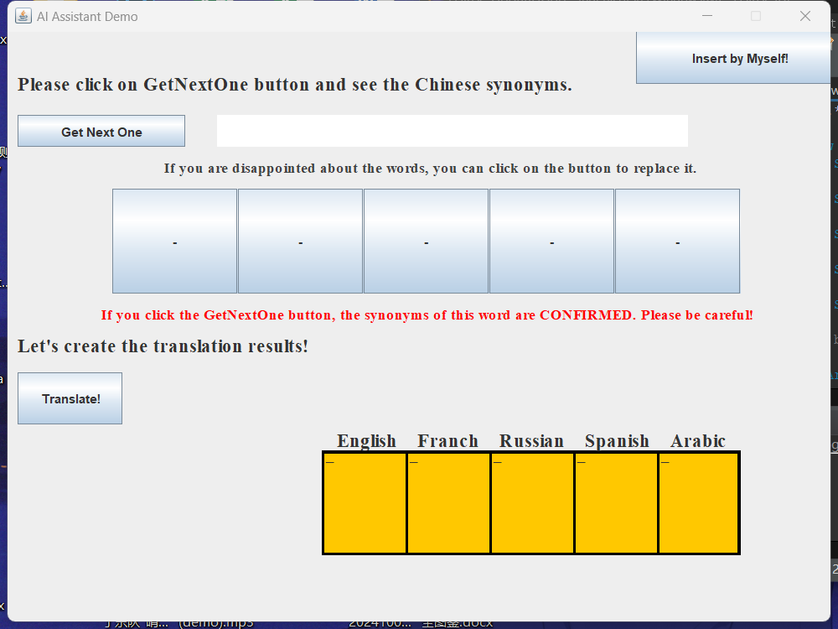
Solution

Slide 6
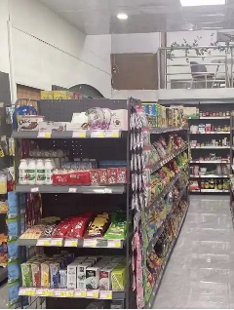

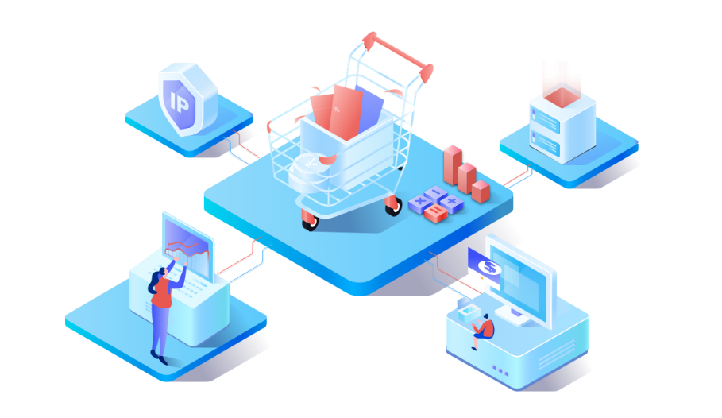
SOLUTION
Partition number and positioning design
Location Tag
According to the layout of the supermarket,
the goods are divided into different areas according to the type.
Commodity area + shelf number + number of shelf layers
eg：The razor in the digital area
Digital Zone-E1-1

Slide 7
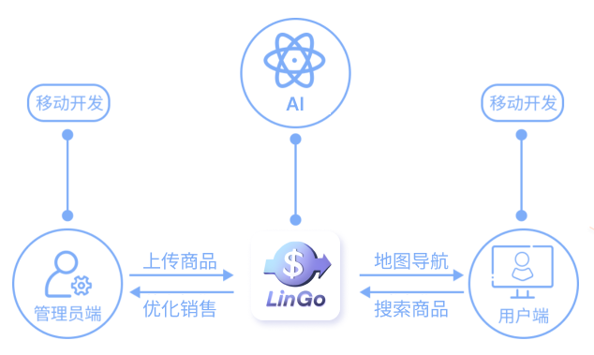
INNOVATIONS
(Mobile development
Mobile development
Mobile development
Upload goods
Map navigation
Optimize sales
Search for products
Administrator's side
User side

Slide 8

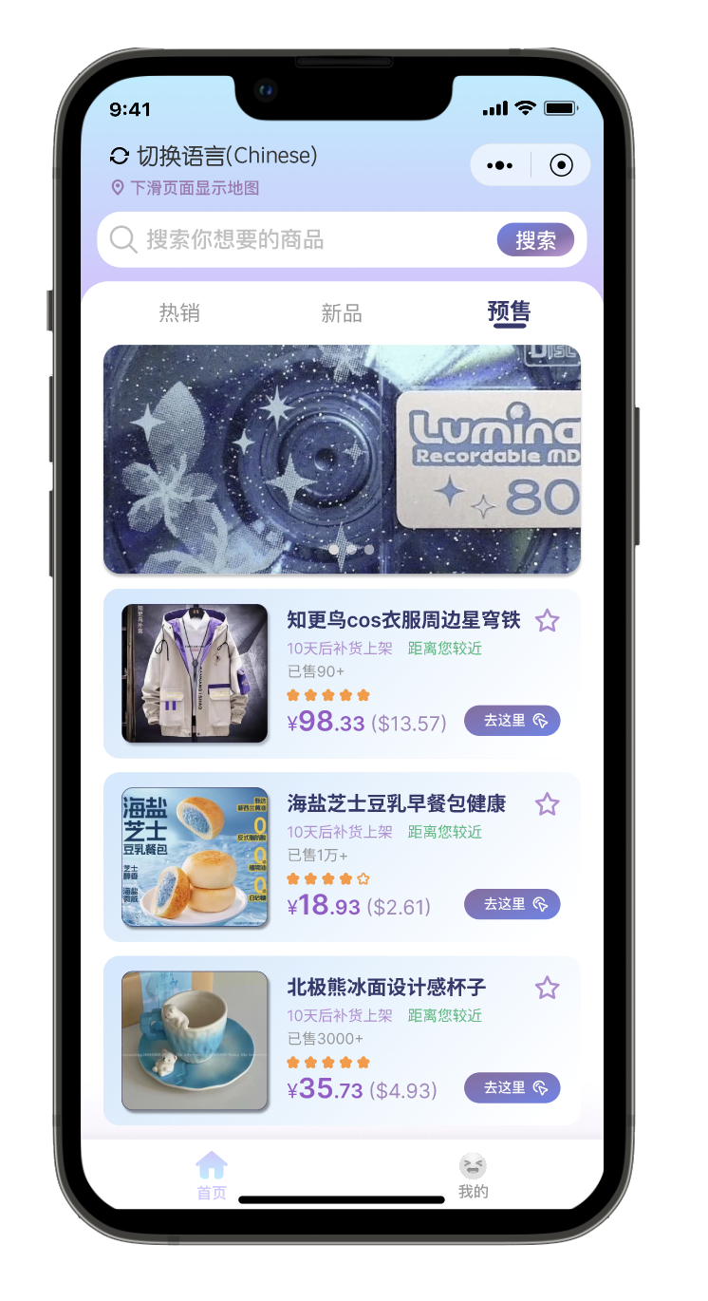
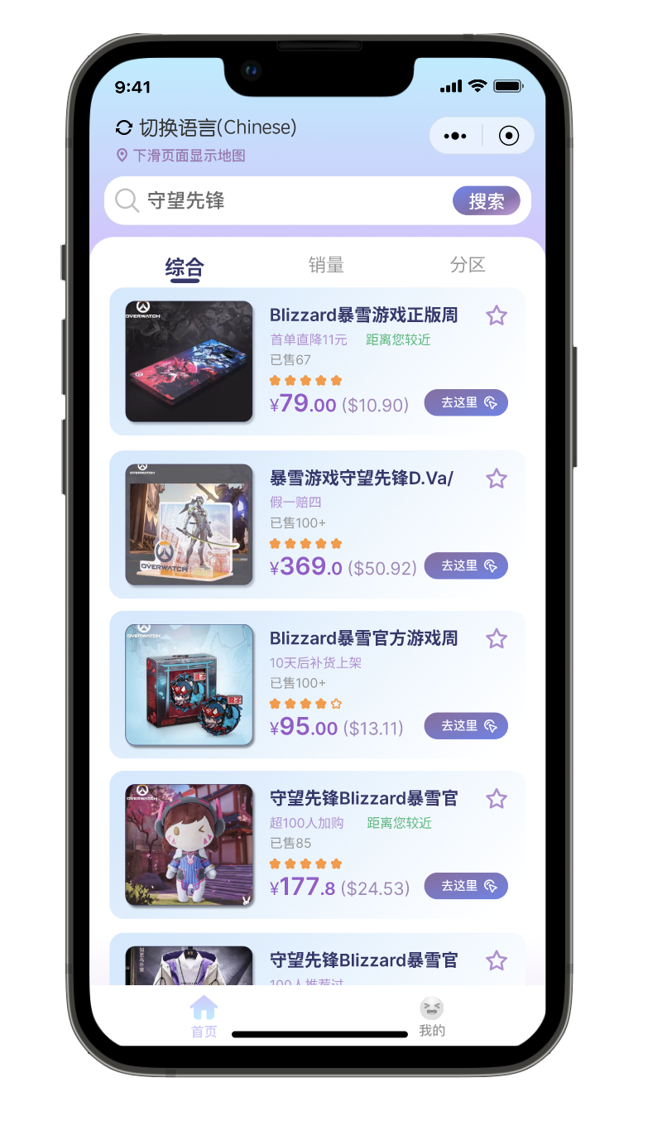
CONCEPT VIDEO

Slide 9
UI
Goods nearby
Multi-Language
Fuzzy Search

Slide 10
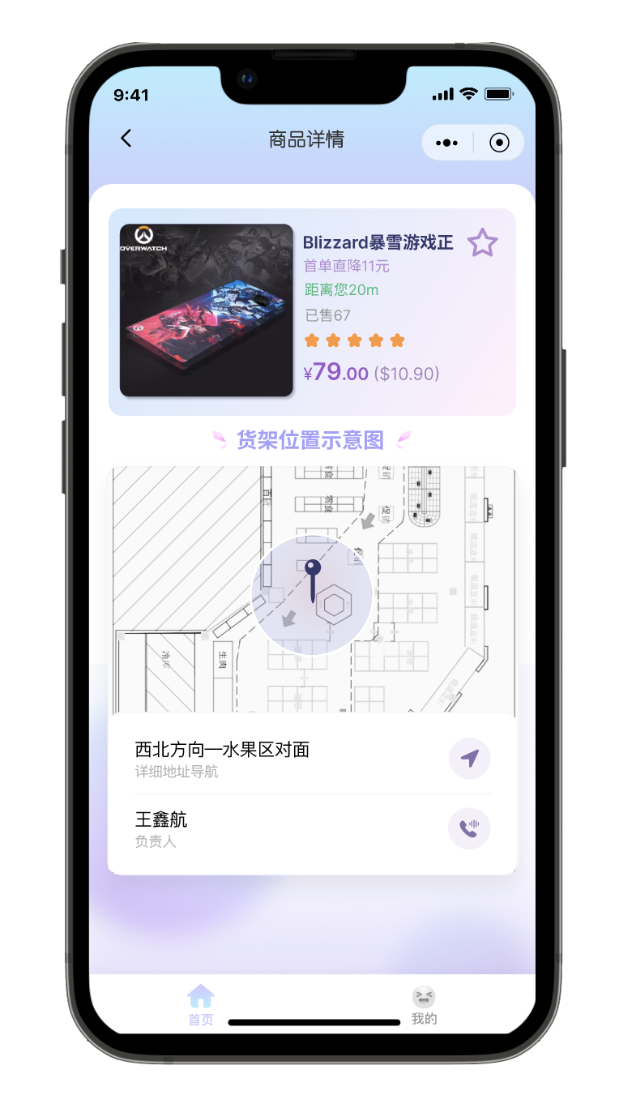
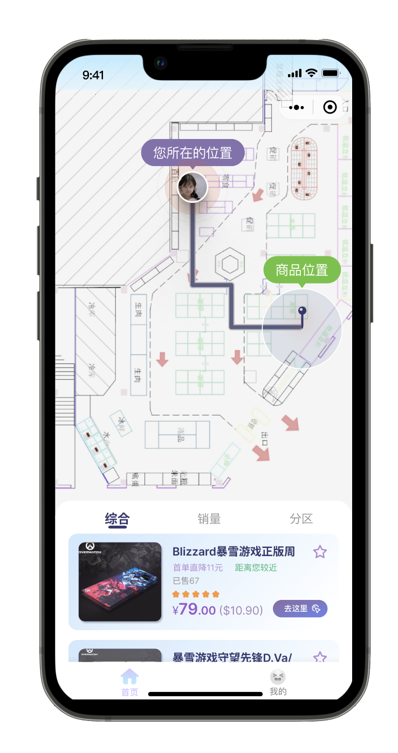

UI
Product Navigation
Clear Navigation
Real-time distance display

Slide 11
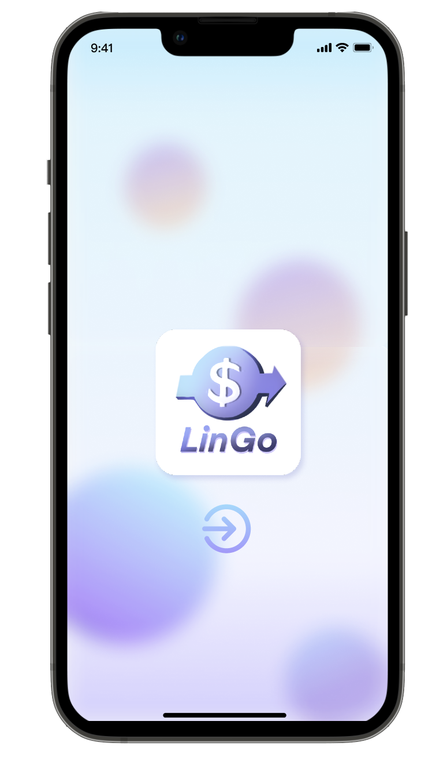
UI
Translate
AI translator
(Five foreign languages)
Fuzzy Search
Synonyms given by AI
销量提升

Slide 12

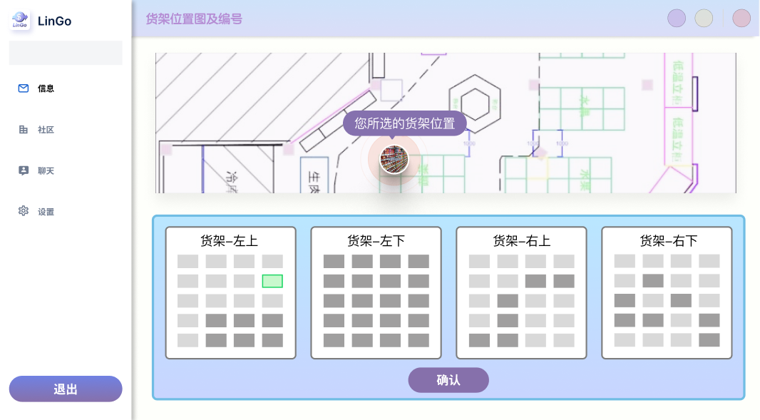
UI
Administrator's side
Easy to operate
concise
There is a prompt for the shelf status.
Audio-visual
销量提升
The shelf indication is intuitive.

Slide 13






TECHS

Slide 14
BUSINESS MODEL
A-end sales
Cost analysis
Agent promotion
Cooperative supermarket
Cost items | Price
Shelf number and partition cost | ¥5500（QR code scheme) ¥9000（RFIDscheme）
The cost of using Al | ¥508.5（every month） ¥6,186.75（every year）
Import and maintenance of data | Certain additional labor costs
B-end sales
Online promotion platform
Lock customer portraits
Combine two ways to promote products

Slide 15
FUTURE
Cooperation
Seek cooperative pilot operation
Company
Establish a company for stable cooperation
Feedback
Collect feedback and update
Radiation Periphery
Expand the pilot radiation periphery

Slide 16
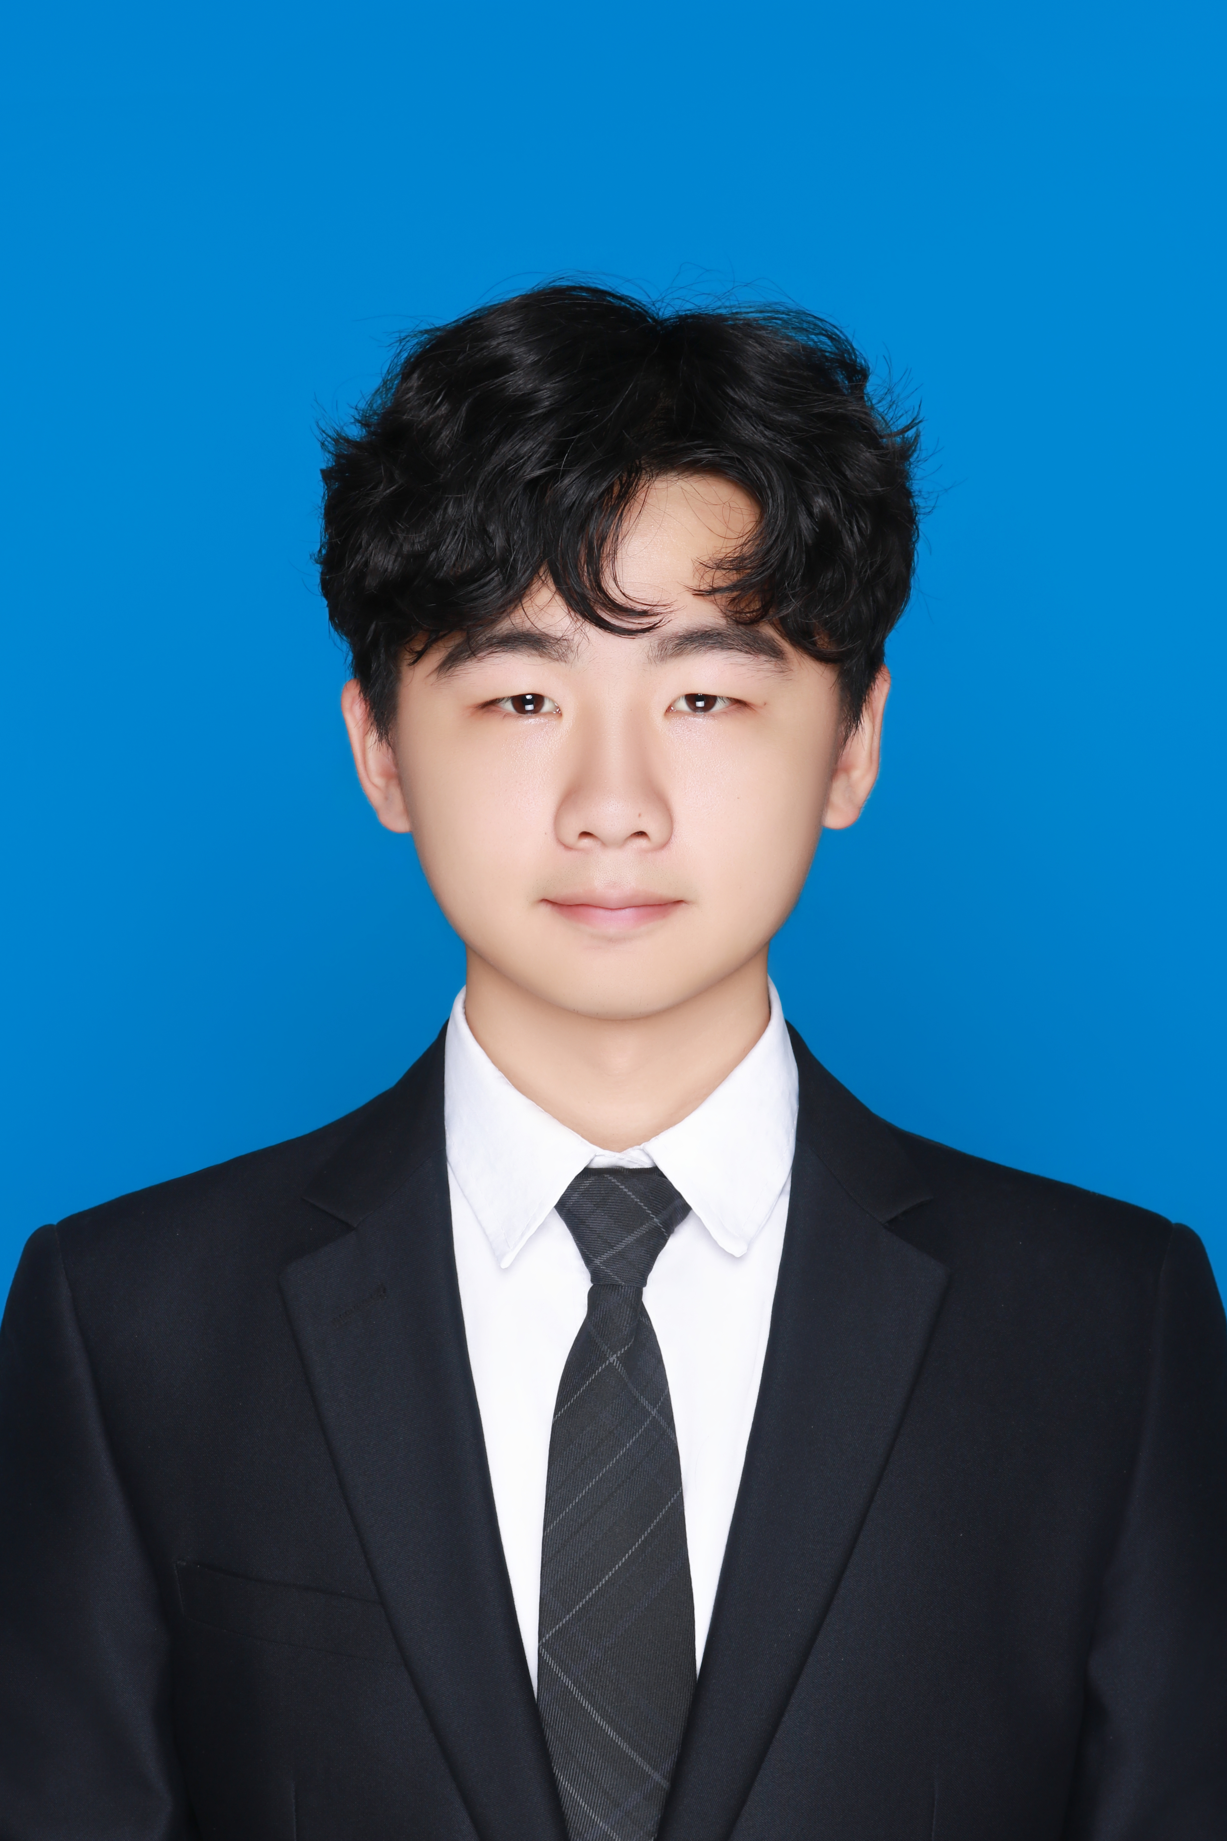

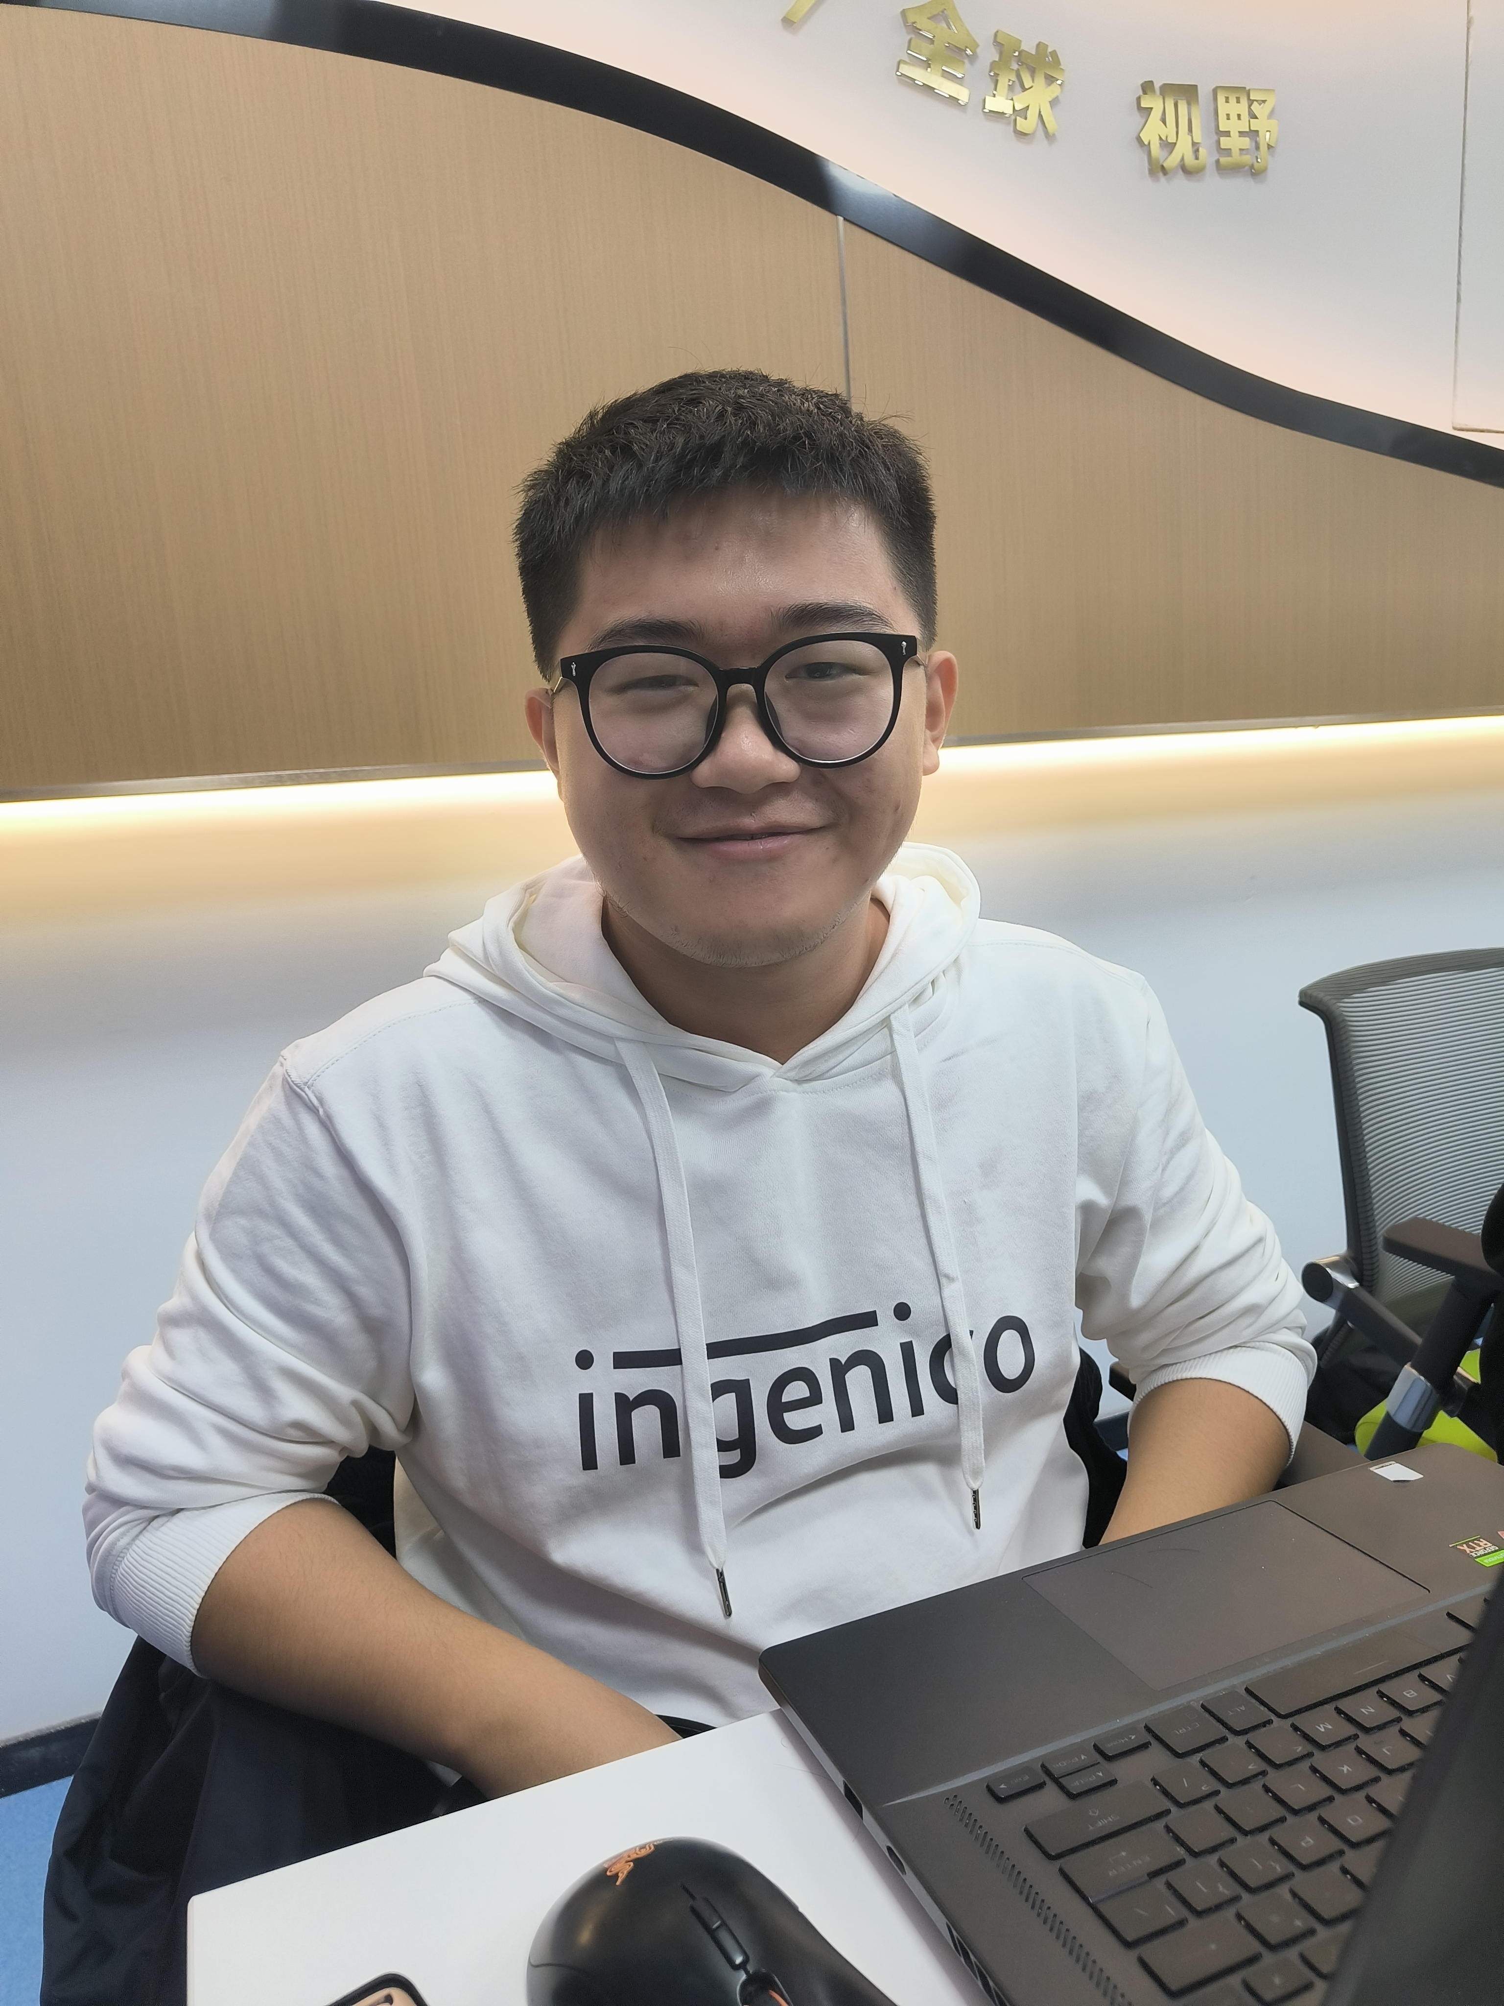

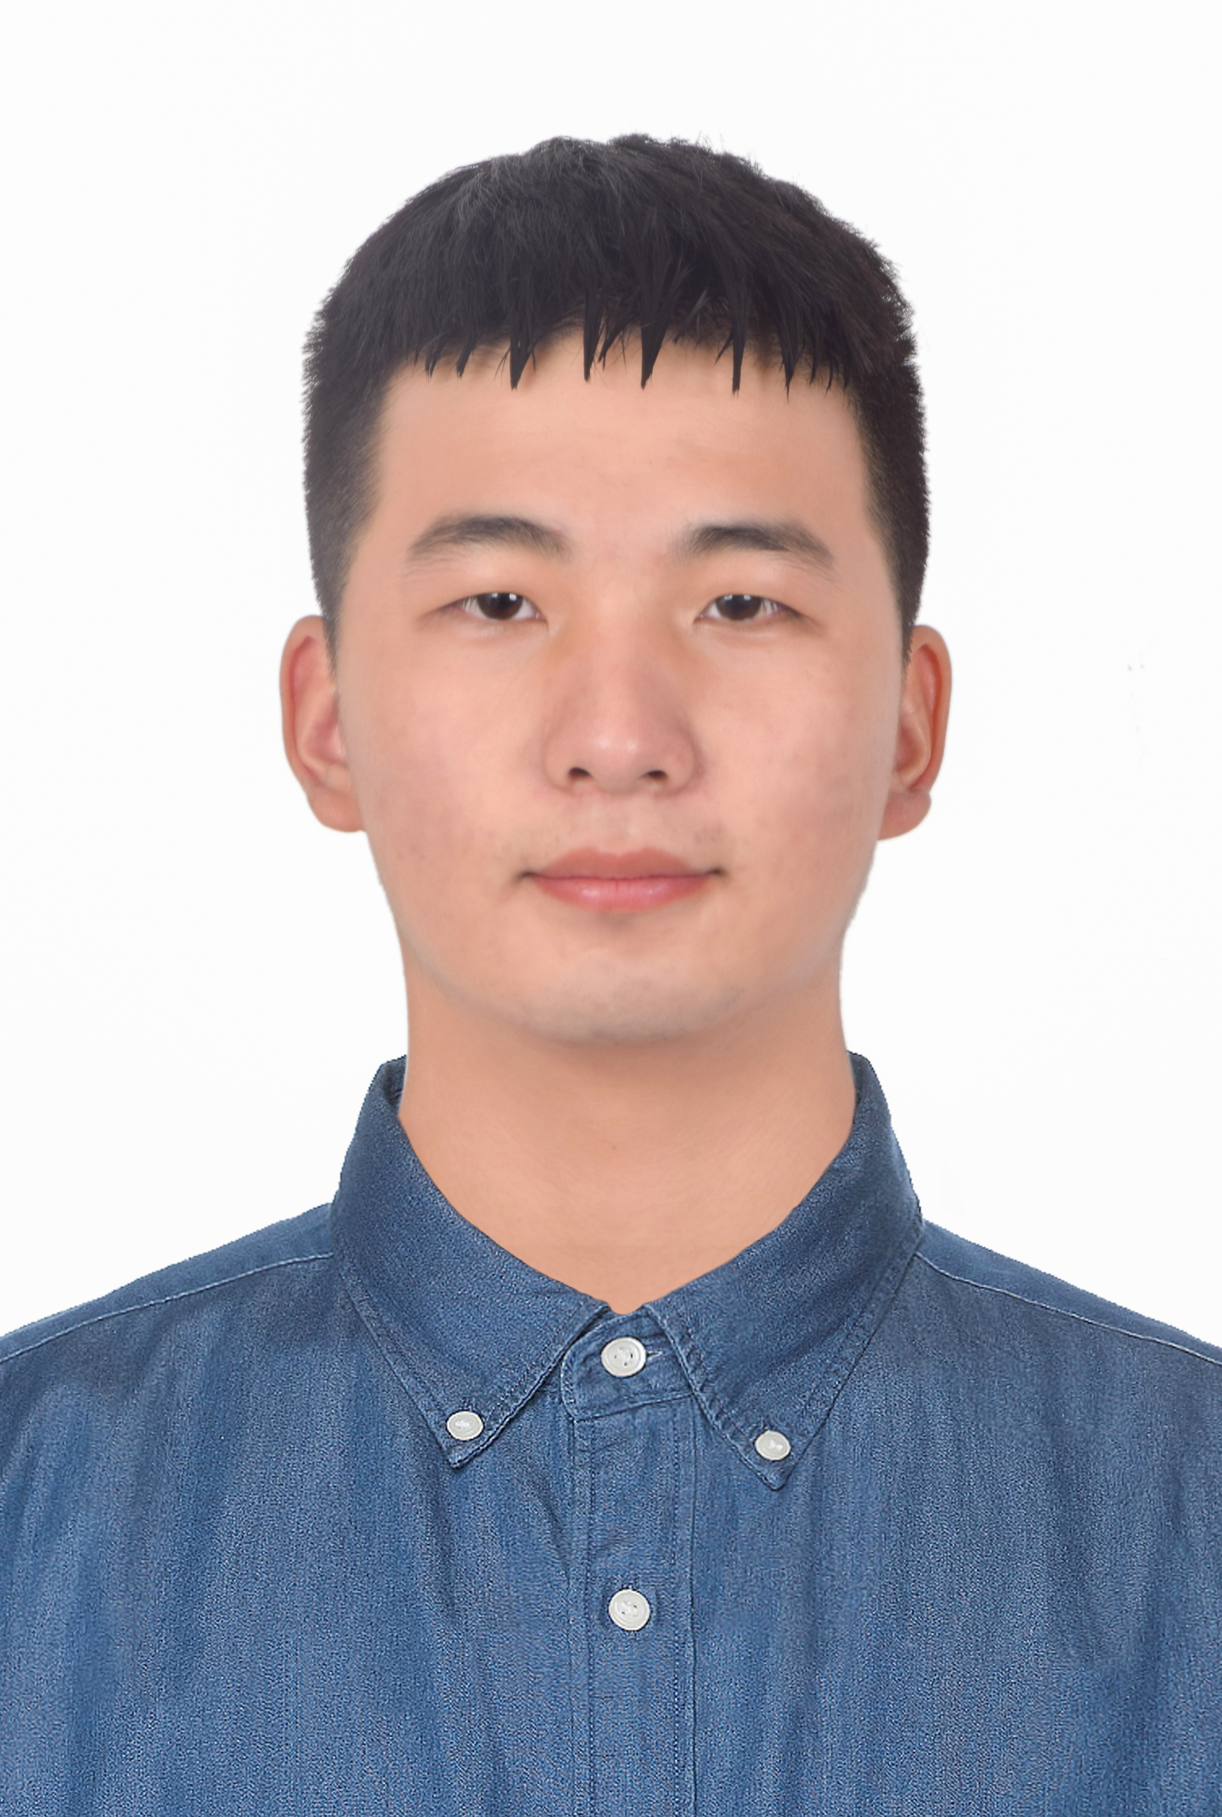
TEAM MEMBERS
胡鑫航
洪鑫裕
林之巍
Project leader
Back-end development
Back-end development
项目负责人
后端开发
后端开发
Back-end development
Al interface call
Speaker
Back-end development
Server-side development
Flow chart, UML design
Back-end development
Design interaction
Database deployment
孙钰婷
范岚琦
UI designer + art
Front-end development
UI设计+美工
前端开发
UI Design
PPT production
Display video production
Front-end development
Visualization

Slide 17
LinGo
Thank you for listening!

